Slide 1
CHIRURGIA ROBOTICA E INTELLIGENZA ARTIFICIALE: NUOVE APPLICAZIONI E STATO DELL’ARTE
Giovanni cesana
UO chirurgia generale, policlinico san marco, zingonia (BG)
Ricercatore presso universita’ vita-salute san raffaele, milano

Slide 2
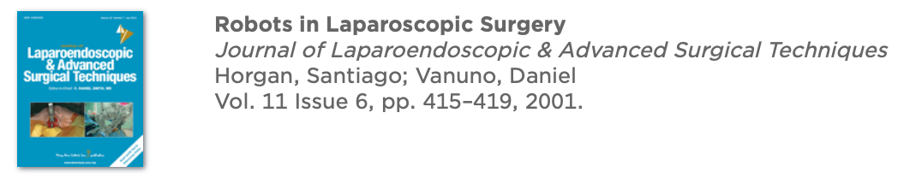
CHIRURGIA ROBOTICA IN BARIATRICA
Nel 2000 FDA approva il sistema DA VINCI per la CHIRURGIA GENERALE.
The robotic system then was used to perform the gastrojejunostomy (two layers: the outer layer with interrupted 3-0 silk sutures and the inner layer in a running fashion with absorbable sutures), similar to the open approach.
Division of General Surgery, Department of Surgery, University of Illinois at Chicago, Chicago, Illinois.
The magnified 3D view and the articulation of the robotic arms allows us to perform a 10-mm anastomosis with more precision and ease than by the conventional laparoscopic approach. For this group of patients, the average operative time was 3 hours and 10 minutes, and the mean hospital stay was 2.3 days.

Slide 3


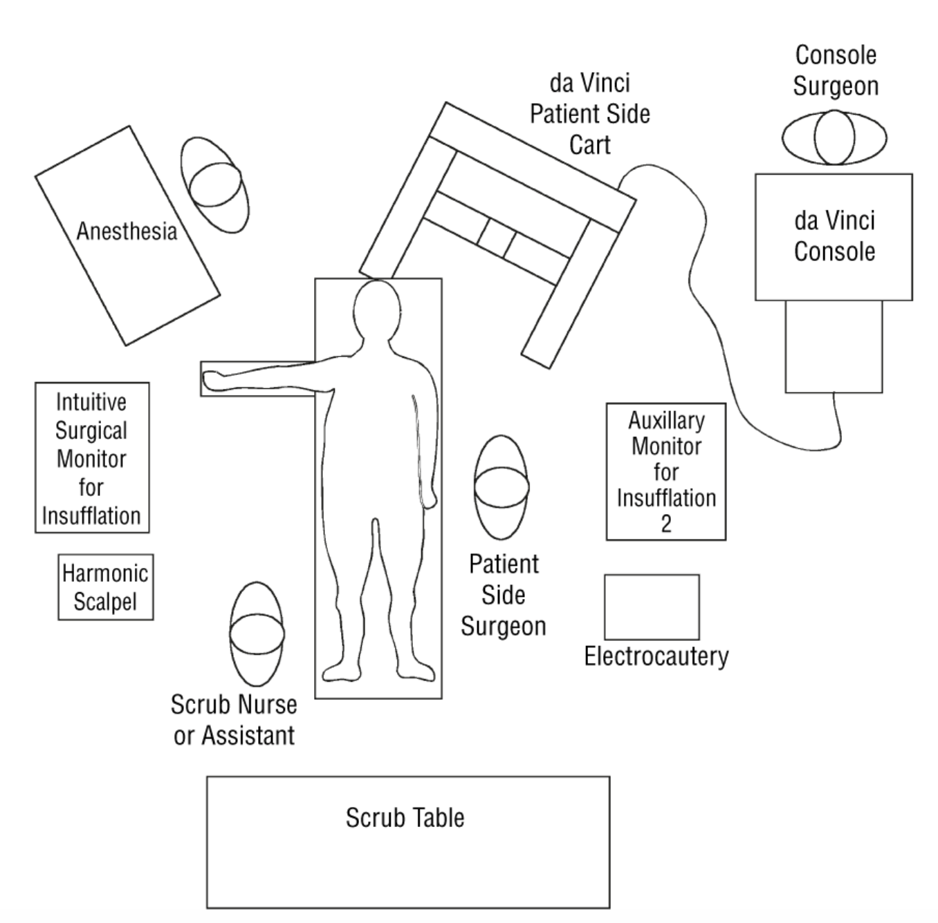
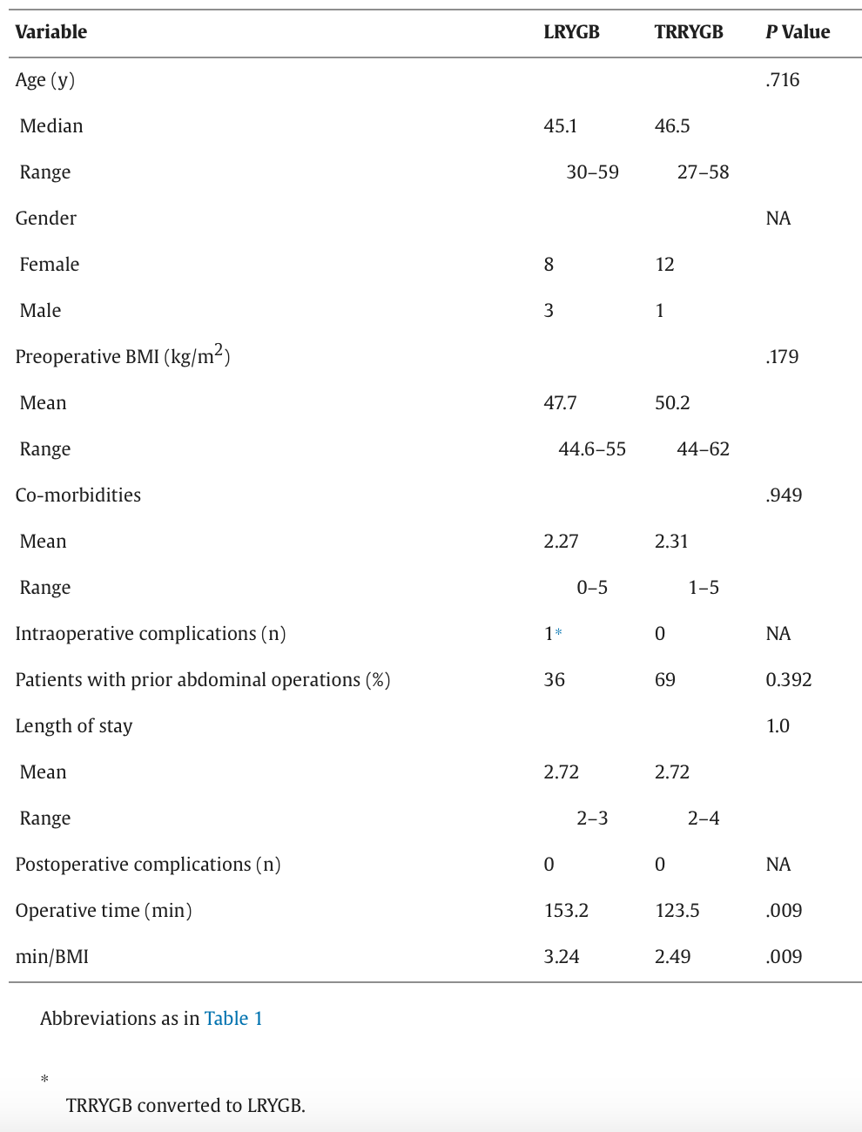
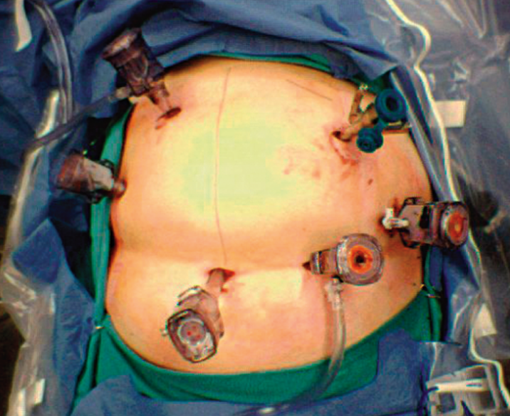
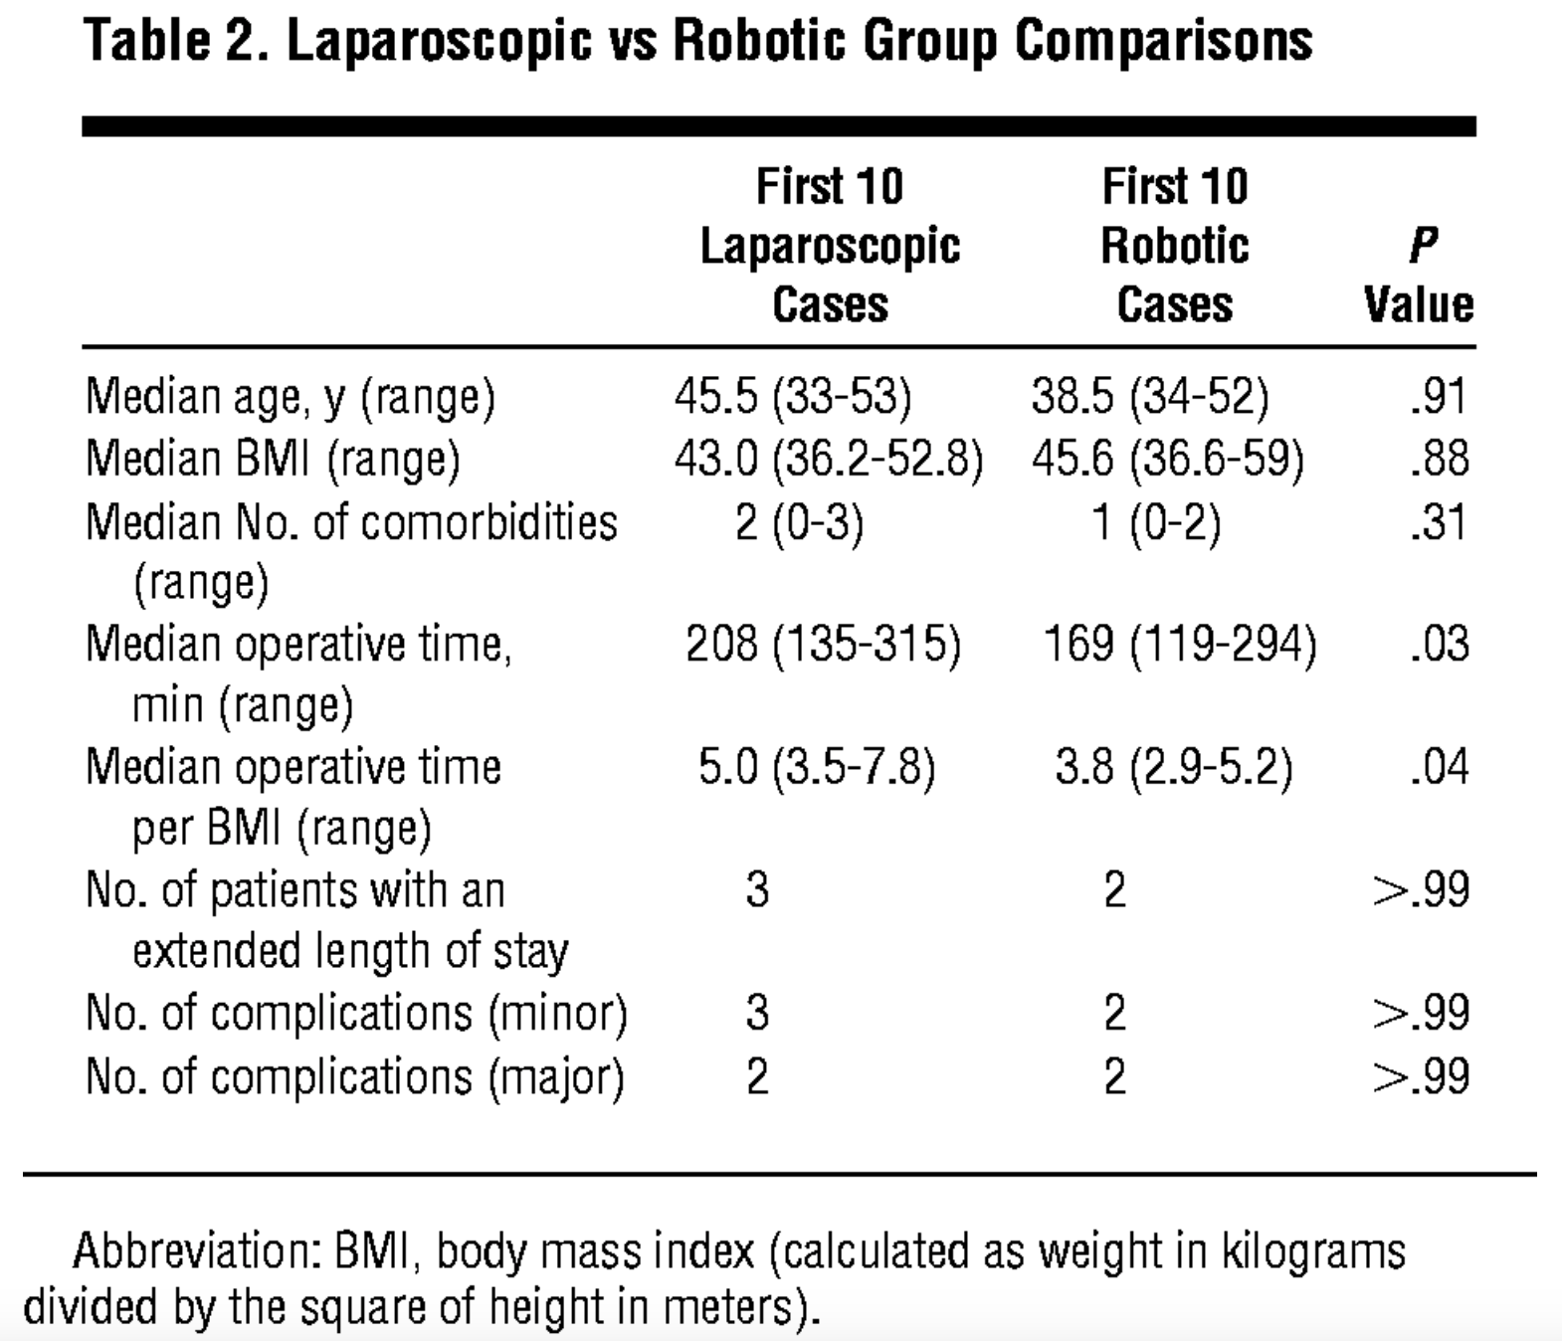
Author Affiliations: Department of Surgery, Stanford School of Medicine, Stanford, Calif.
Department of Surgery, Stanford University Medical Center, Stanford, California
Setup times and operative times were inversely proportional to the number of cases performed.
Preparation for the robot can be decreased to as few as 6 minutes and the robotic work time can diminish by 50%.
A major concern when considering the use of the Da Vinci system is the cost. The system acquisition cost is 1 million dollars on average. In addition, the per case cost of the instruments we use is approximately $900, and the annual service cost is 10% of the capital cost.
Mean operative time

Slide 4

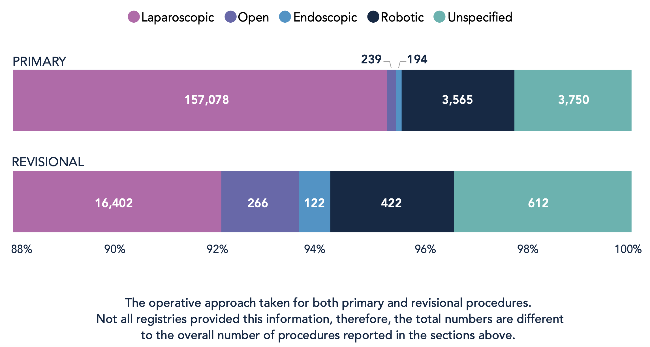
Data from the IFSO Registry 2023 show that robotic platforms are used in nearly 30% of all bariatric procedures in the United States (US). However, this is not the case in Europe and other continents, where the use of robotic platforms is less well-documented and accounts for less than 10% of procedures in many countries

Slide 5

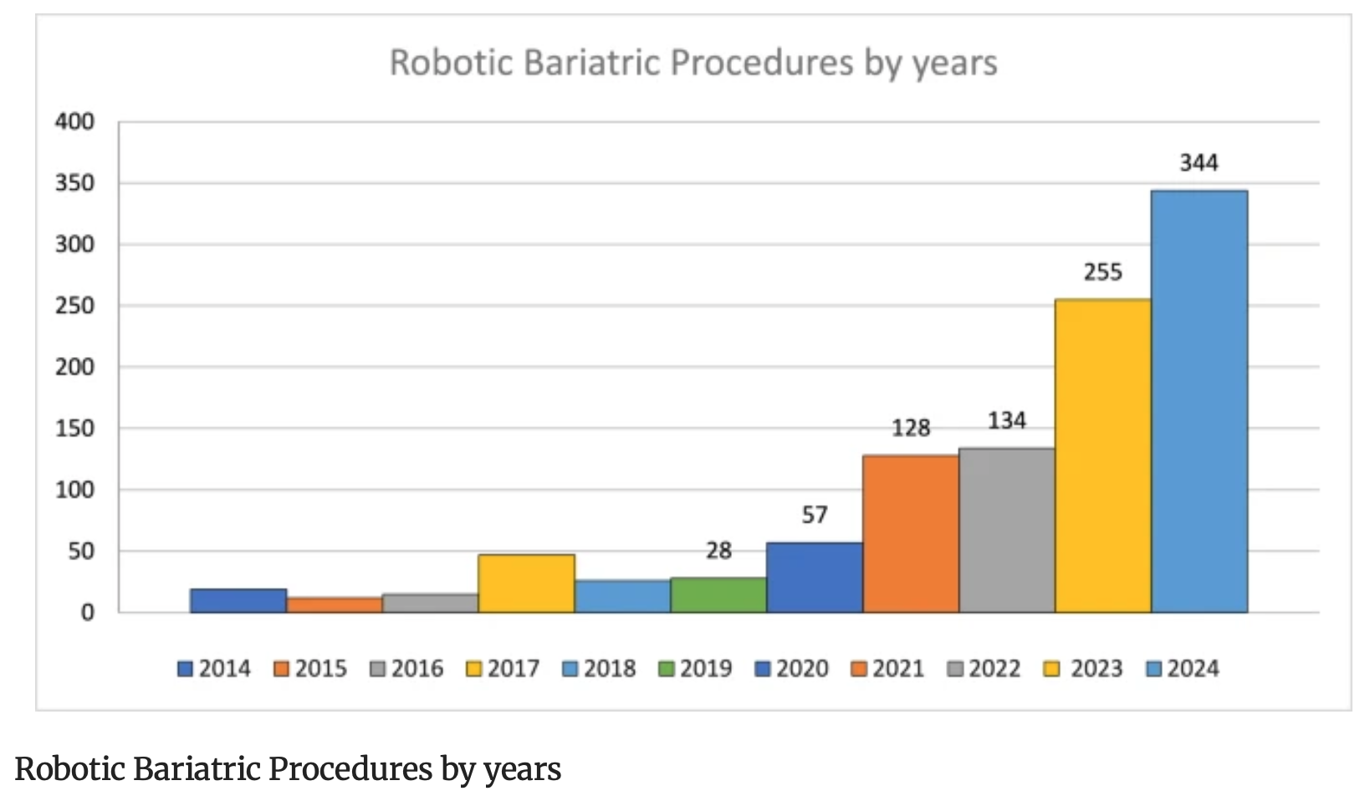
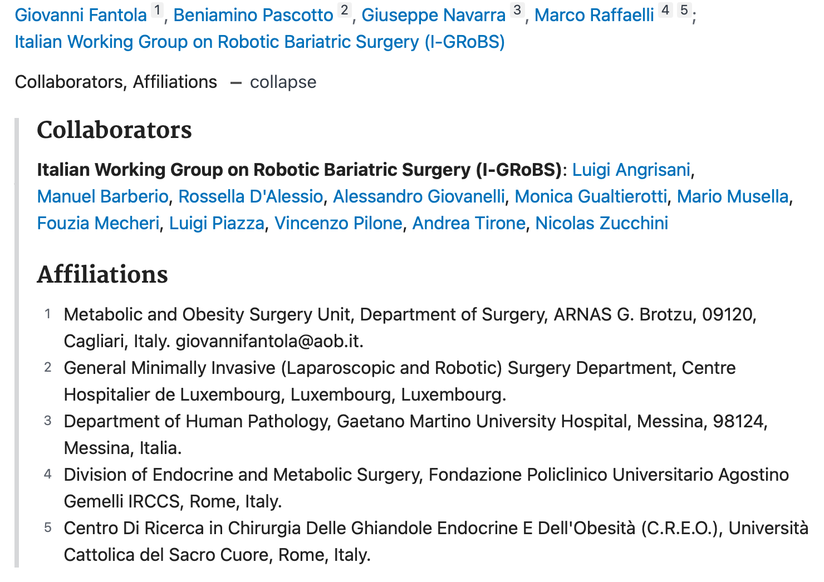
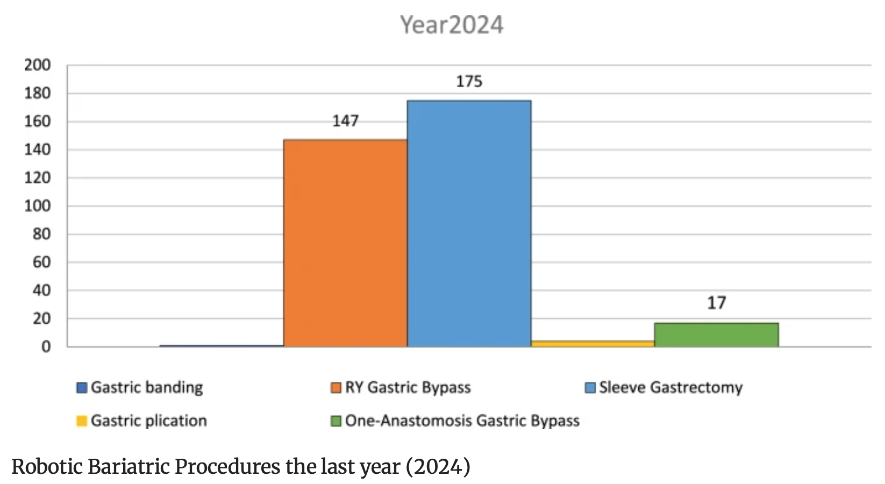
3,7%
0,2%

Slide 6
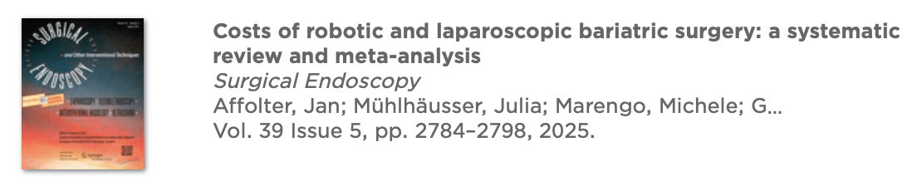

A total of 14 retrospective studies (293 articles screened) were included, with 1,414,357 patients (112,363 robotic; 1,301,994 laparoscopic).
Total hospital costs favored laparoscopic surgery (SMD 0.721, 95%CI: 0.555–0.887, p < 0.001, absolute difference USD 3819).
Operating room costs also favored laparoscopy (SMD 1.339, 95%CI 0.202–2.476, p = 0.021, absolute difference: USD 9746).
Laparoscopy was associated with shorter operative time
Robotic surgery showed a slight advantage in hospital stay and complication rates.

Slide 7
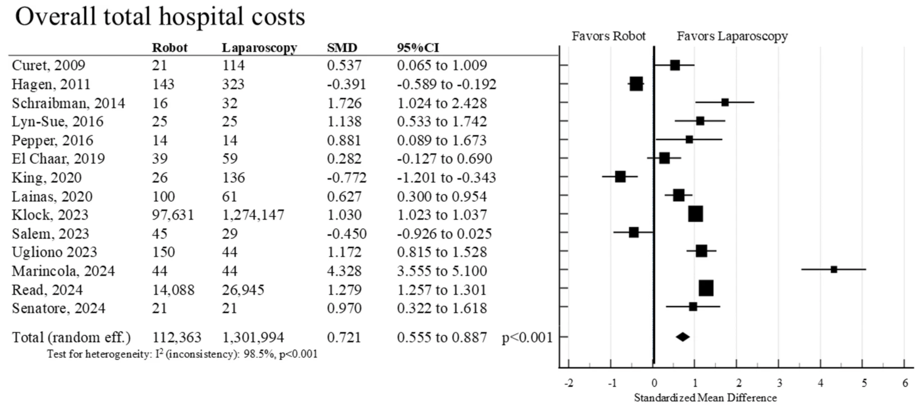
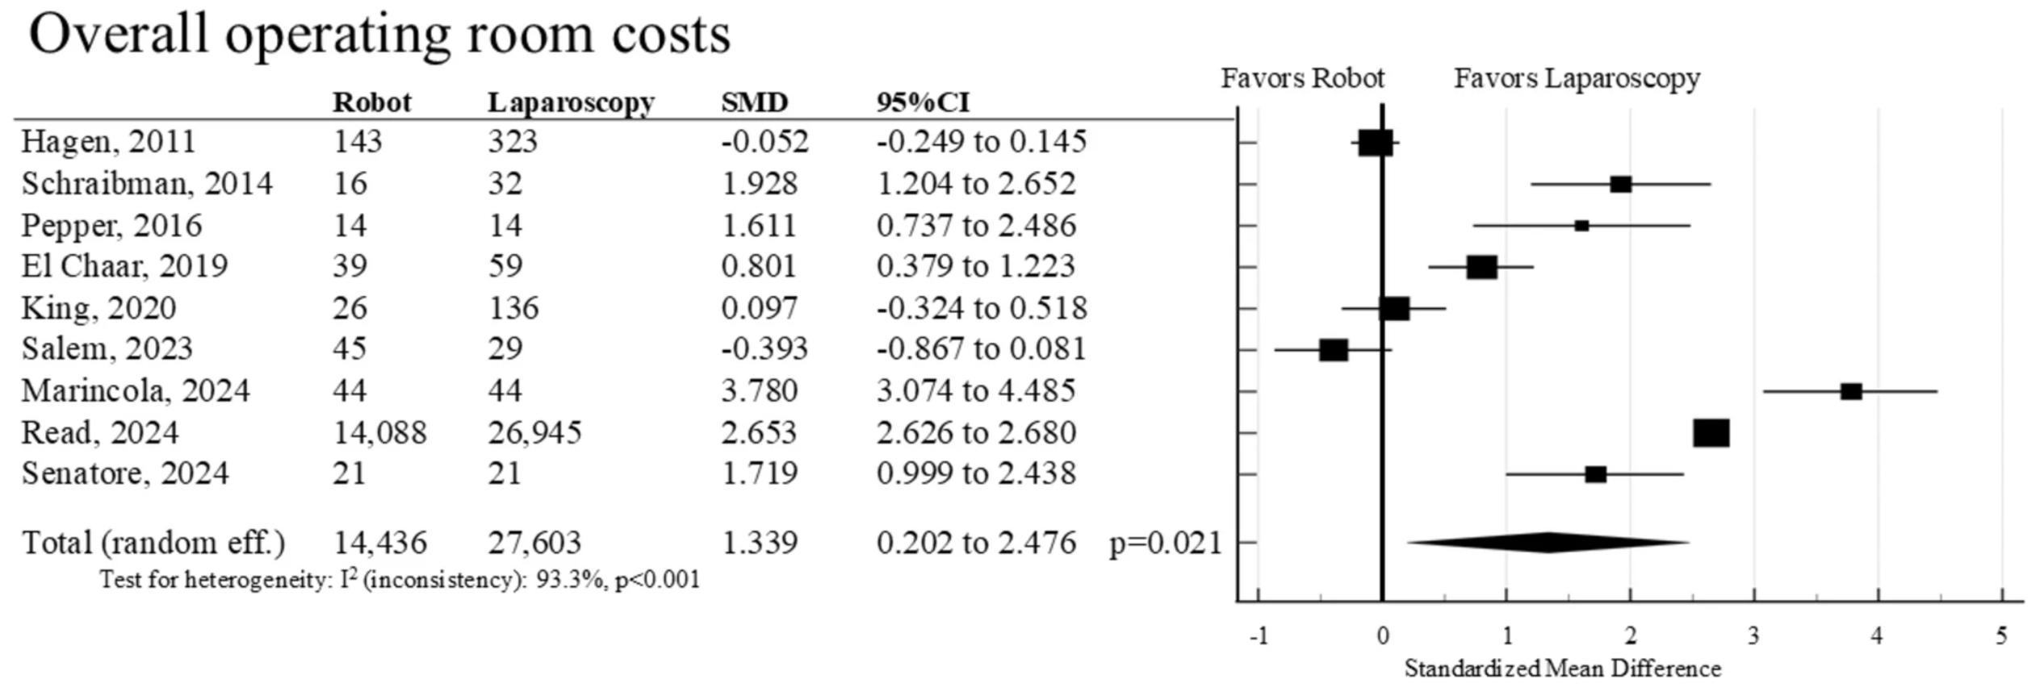
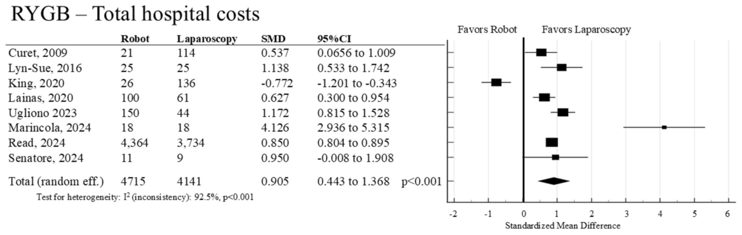
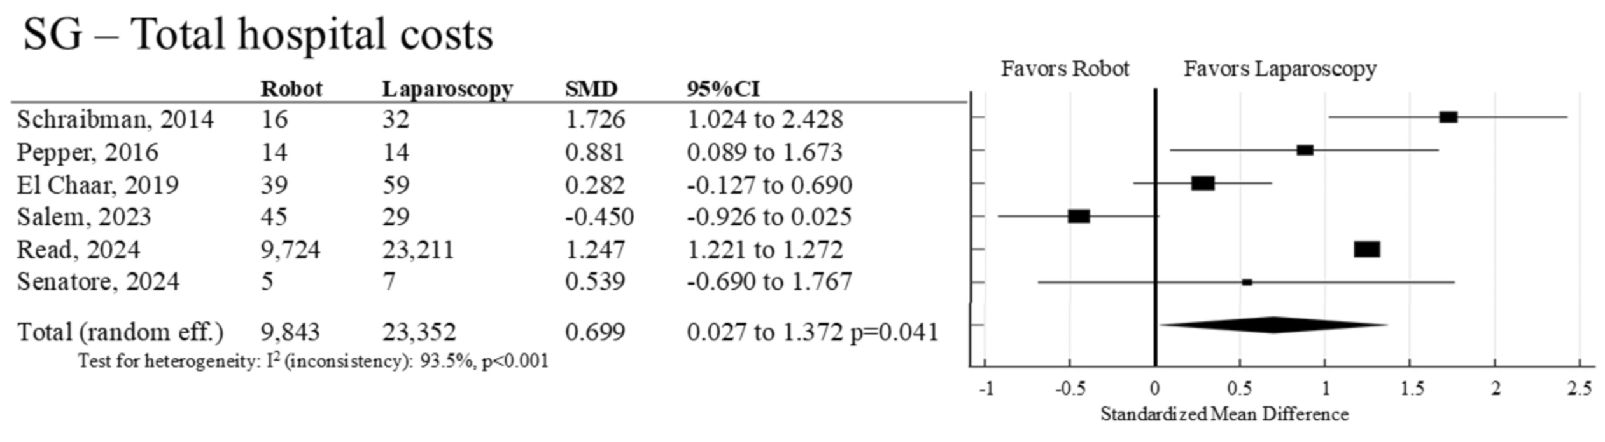
COSTI

Slide 8
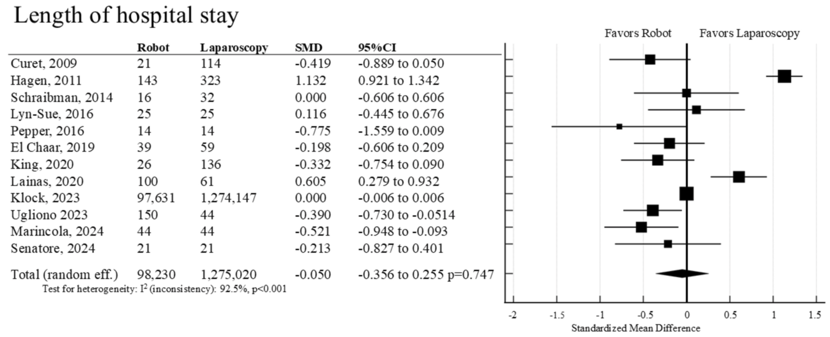
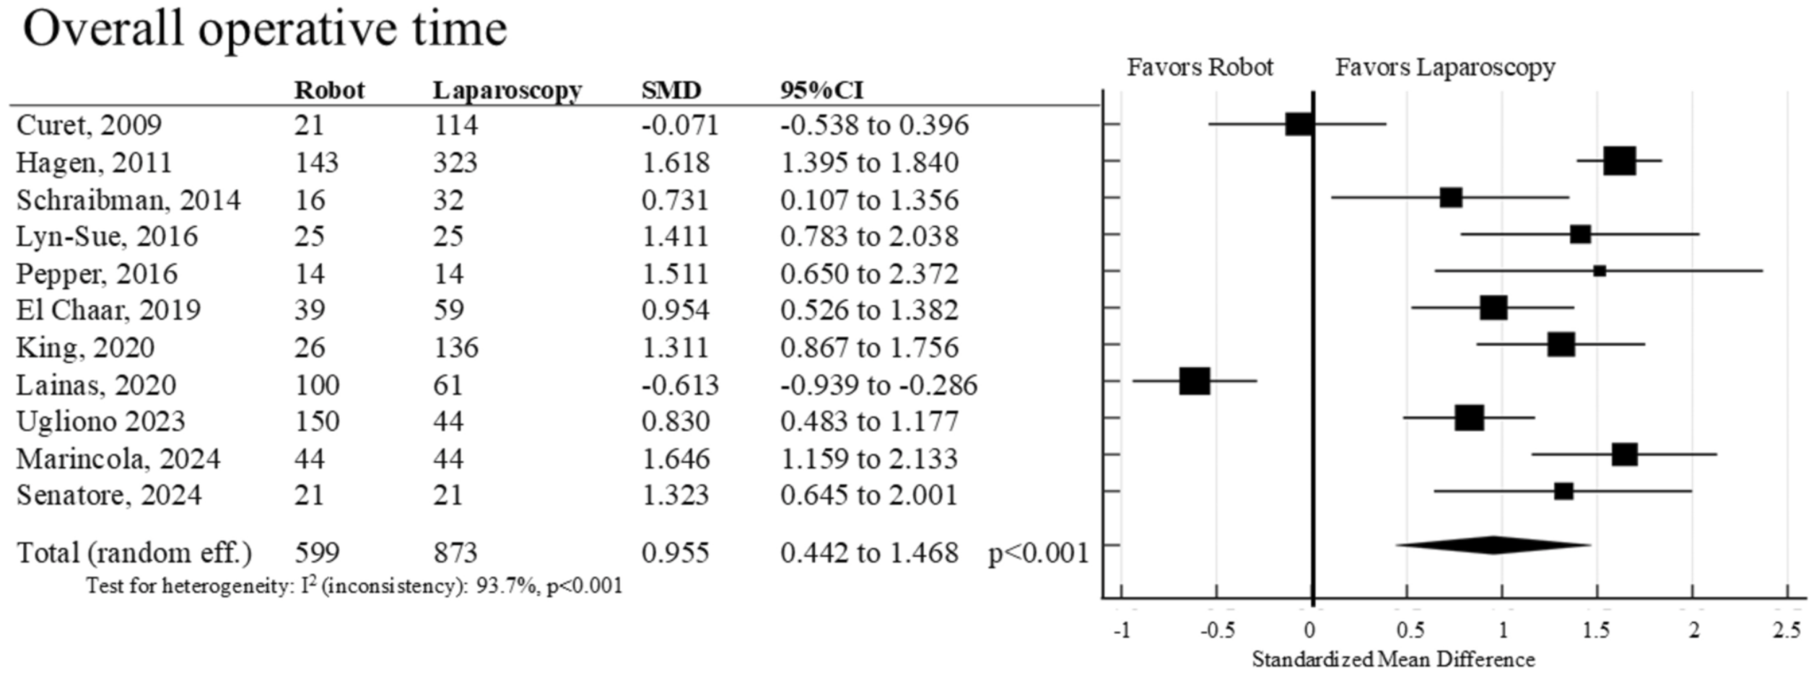
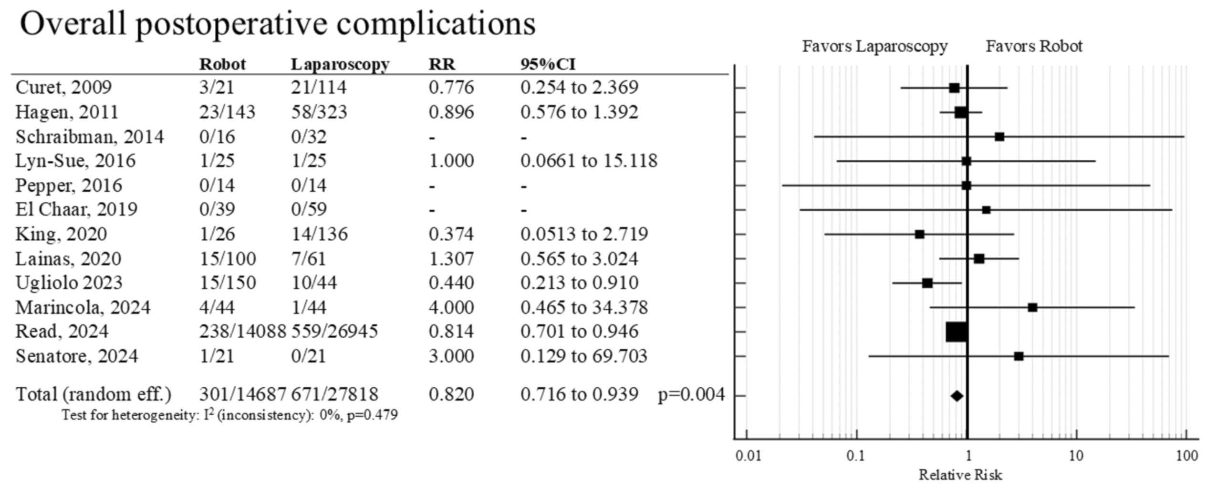
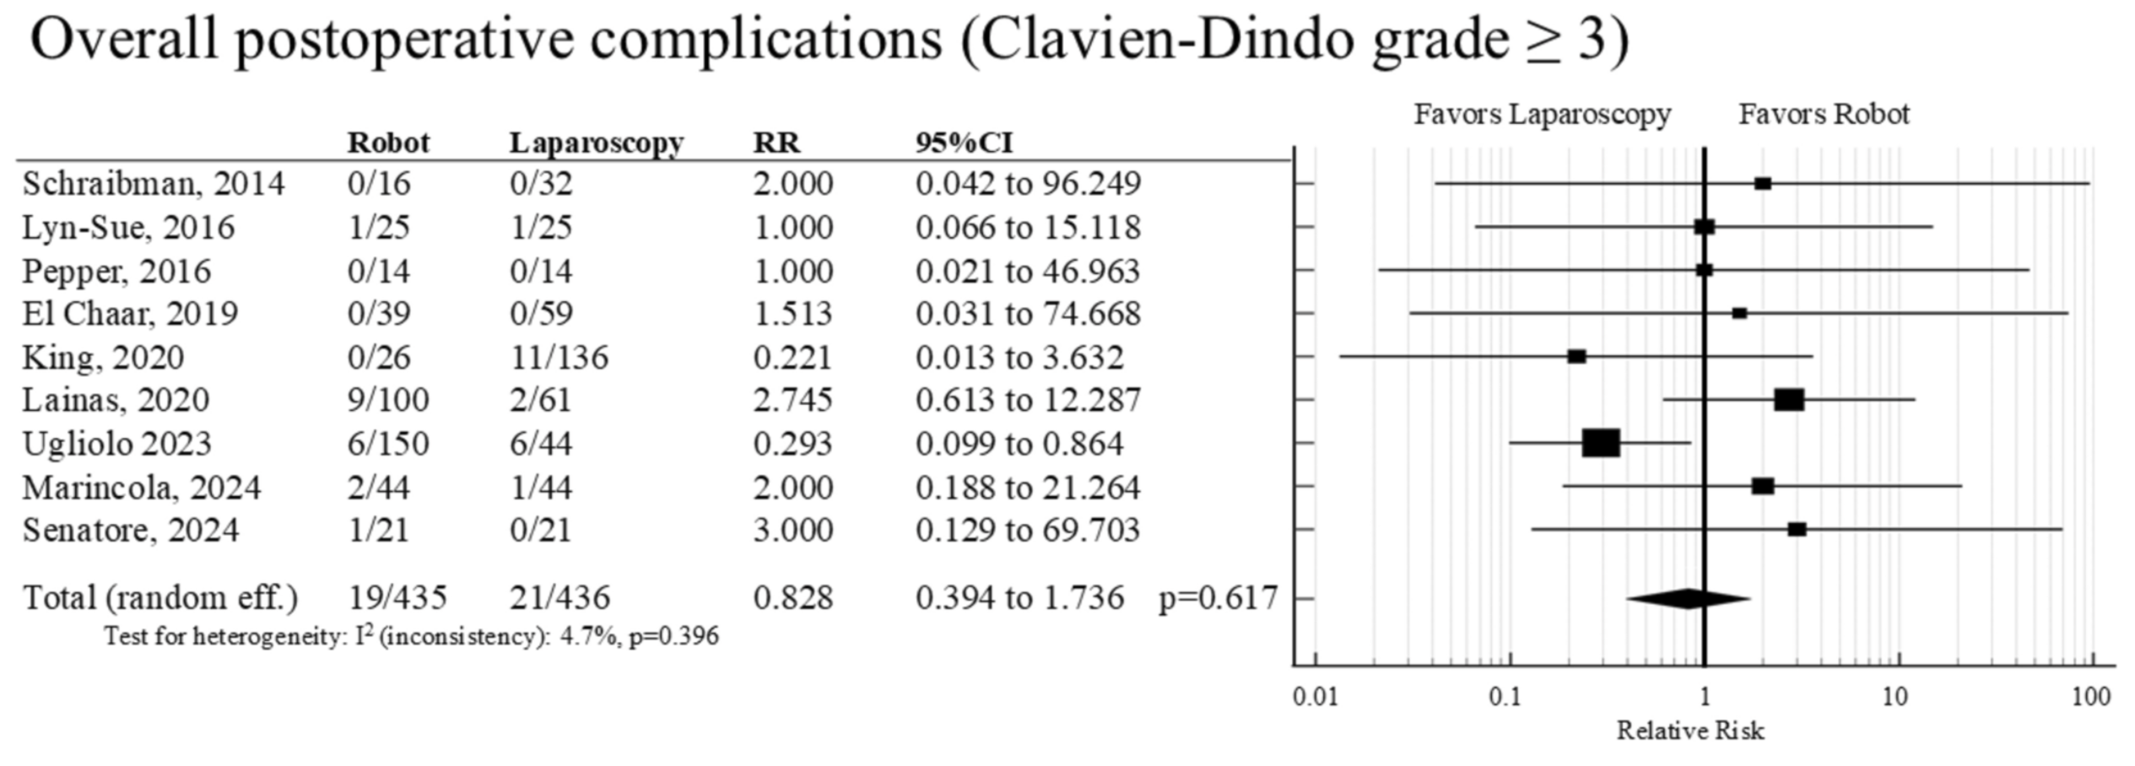
TEMPO OPERATORIO, DEGENZA, COMPLICANZE

Slide 9
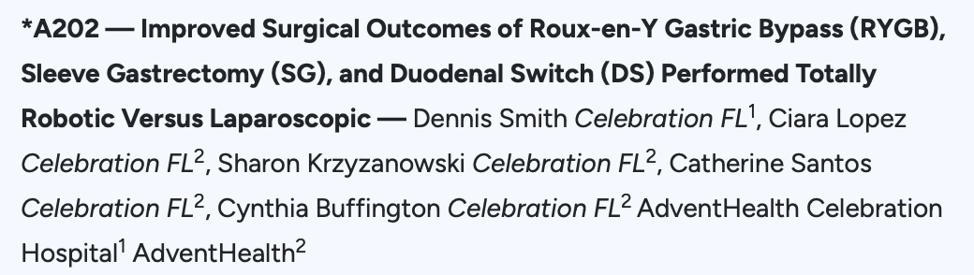

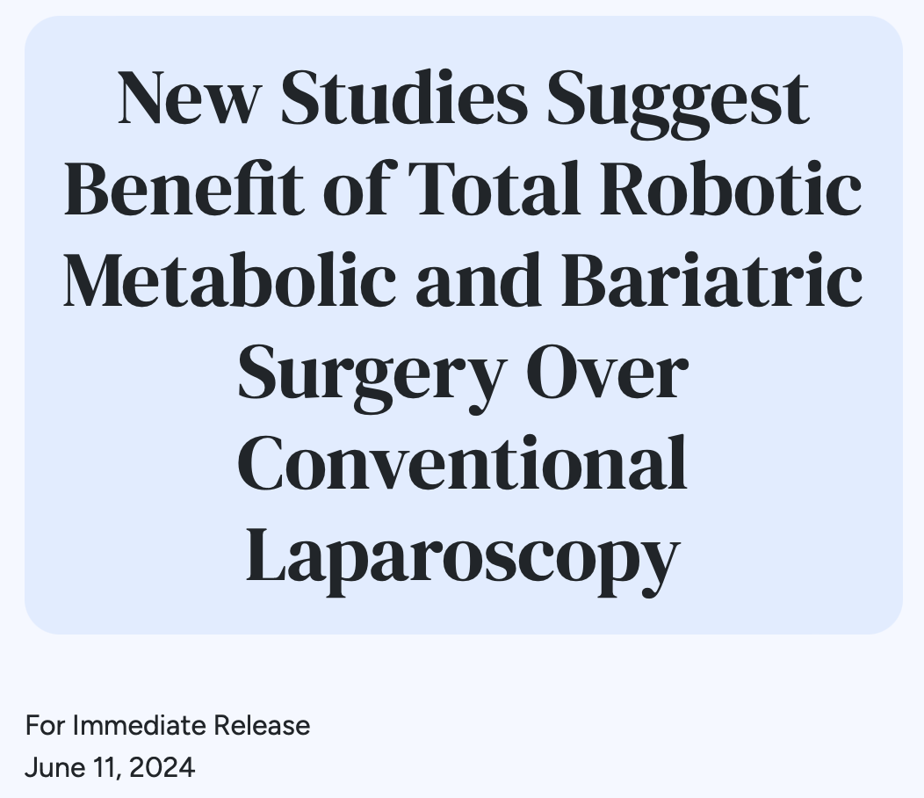
Outcomes of a single surgeon who performed 809 metabolic and bariatric operations – 498 totally robotic and 311 laparoscopic — between 2020 and 2023.
They found total robotic RYGB resulted in significantly shorter operative times (97.6 min. vs. 115.4 min), reduced hospitalization (1.19 days vs. 1.39 days), and lower complication rates (1.7% vs. 5.1%) compared to conventional laparoscopy.
Total robotic sleeve similar benefits– less operative time (47.4 min. vs. 53.1 min.), shorter length of stay (1.14 days vs. 1.30 days), and fewer complications (0.8% vs. 3.2%).
The surgical approach to a duodenal switch did not influence operative times and complication rates but the total robotic approach did result in shorter lengths of stay.

Slide 10
This study comes after recent meta-analyses and registry reports found metabolic and bariatric surgery performed robotically had similar outcomes to conventional laparoscopy but with longer operative times and higher costs.
The researchers note, however, that most of the robotic surgeries in these reports were robot-assisted rather than totally robotic.

Slide 11
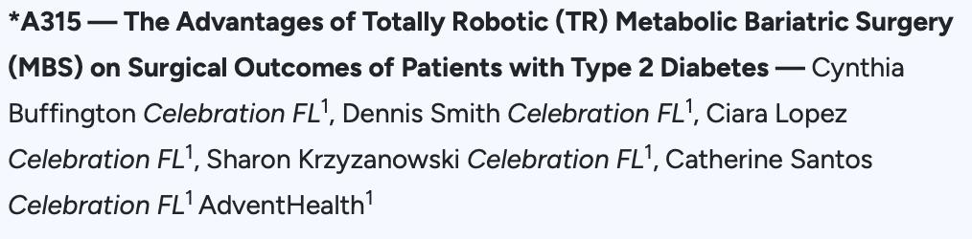
In a second study, these same researchers report improved outcomes and efficiencies for robotic procedures involving patients, this time with severe obesity and type 2 diabetes. A total of 744 patients received either totally robotic (n= 469) or laparoscopic RYGB or sleeve gastrectomy (n=275). Major complication rates for patients with diabetes (2.4% vs. 8.3%), length of stay (1.19 days vs. 1.48 days) and operative times (71.7 min. vs. 90.5 min.) were all lower compared to laparoscopy and were comparable to rates seen with patients with no diabetes. The average preoperative BMI was 46.1.

Slide 12
CONSIDERAZIONI
Learning curve chirurgo
favore
sfavore
Learning curve equipe
Organizzazione sala op
Visione 3D magnificata
Ampiezza dei movimenti – articolarità dei bracci robotici
Facilità nell’eseguire anastomosi manuali
Minor fatica per il chirurgo
Tempi
Costi
Studi futuri: stratificare i risultati considerando la learning curve
Apertura del mercato
Maggior precisione

Slide 13
Where are we going?
È probabile che i prossimi anni rappresenteranno un turning point nell’utilizzo della chirurgia robotica in bariatrica
La piattaforma robotica dovrebbe essere utilizzata per tutte le procedure bariatriche o solo per procedure selezionate?
Le procedure bariatriche più complesse rappresentano un’area promettente per la chirurgia robotica.
La chirurgia robotica può essere validata per RYGB a basso rischio e per tutte le Sleeve.
Revisione
Obesità di classe 4 o 5
Anastomosi manuale (e.g., SADIS)
La chirurgia robotica può essere implementata in Centri di Apprendimento, in quanto ha una learning curve più sicura della laparoscopia.
Procedure che associano la riparazione di ernia jatale

Slide 14

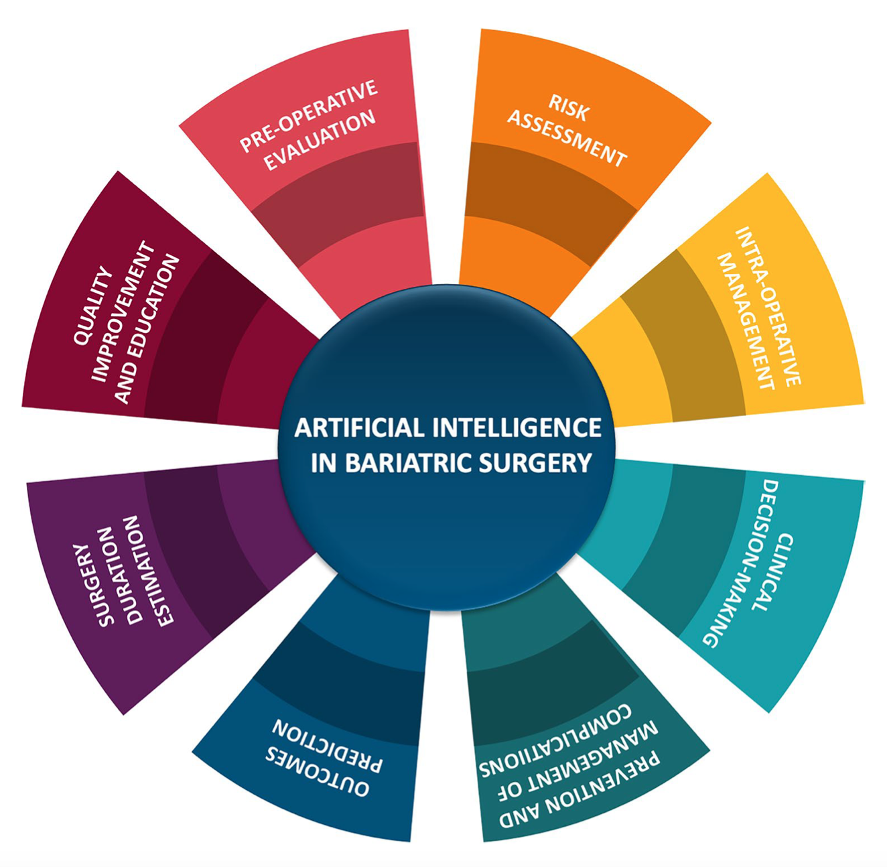
Department of Medicine and Surgery, University of Parma
L’Intelligenza Artificiale in Chirurgia Bariatrica può essere utilizzata in tutti gli aspetti del percorso peri-operatorio.
Machine learning
Deep learning
Previsione rispetto a big data
Previsione rispetto ad immagini

Slide 15
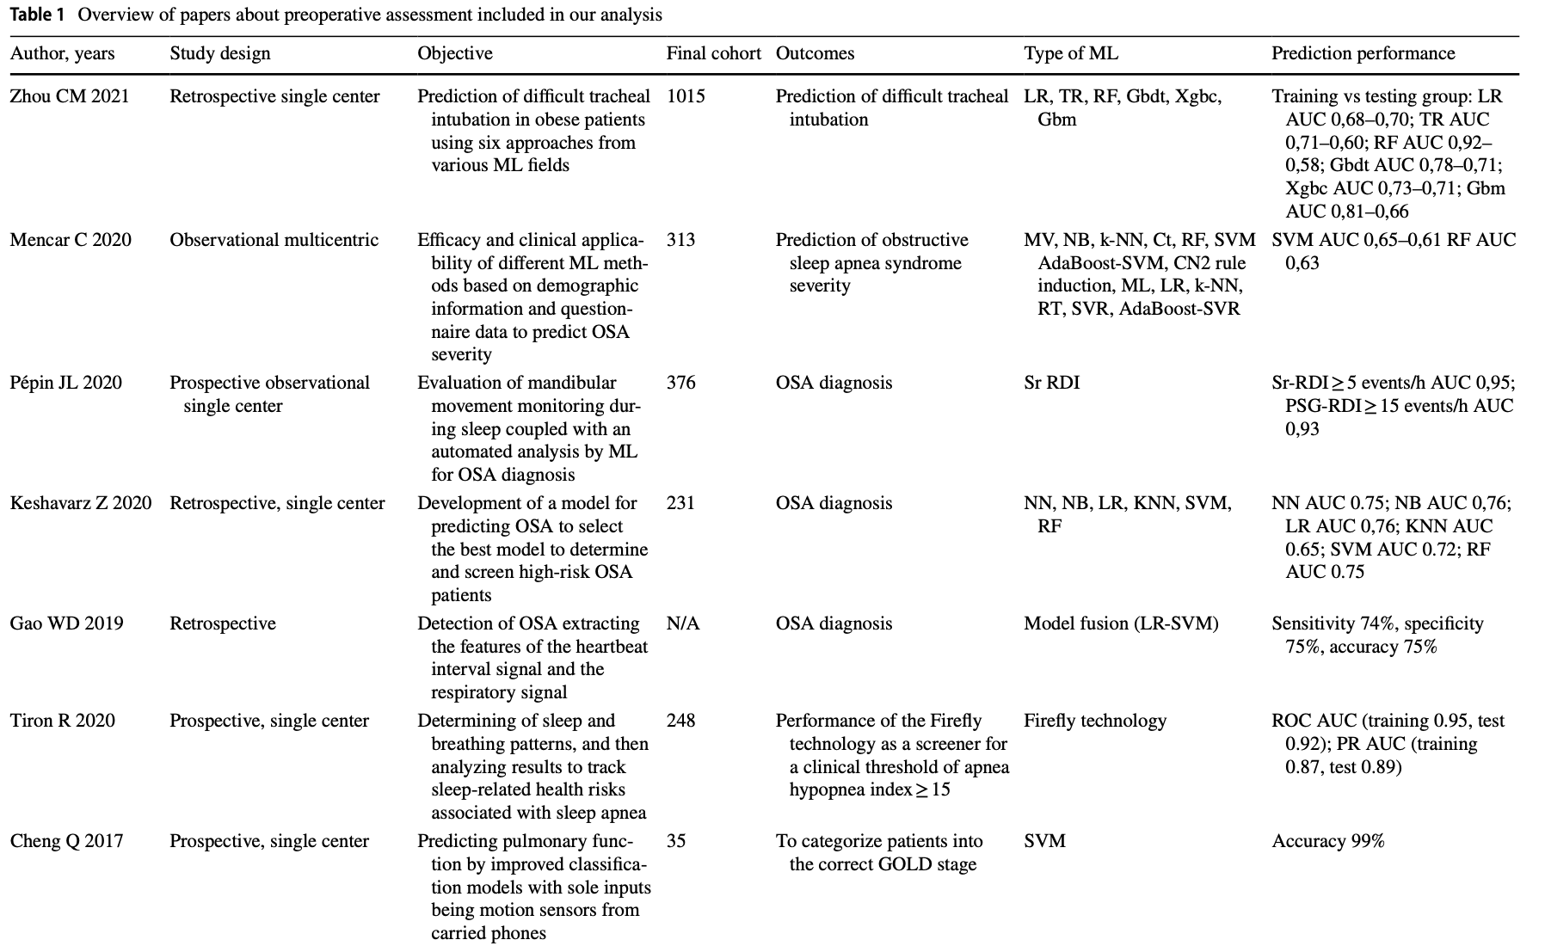

Slide 16
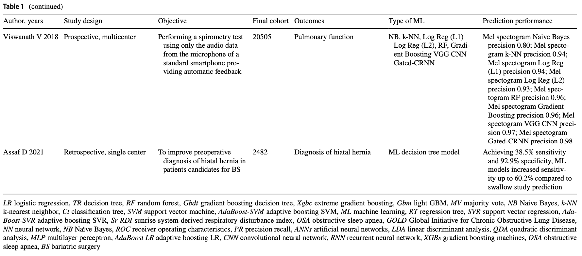

Slide 17
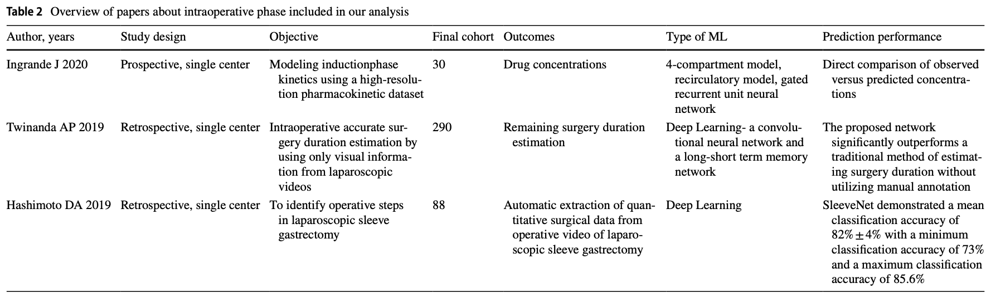

Slide 18
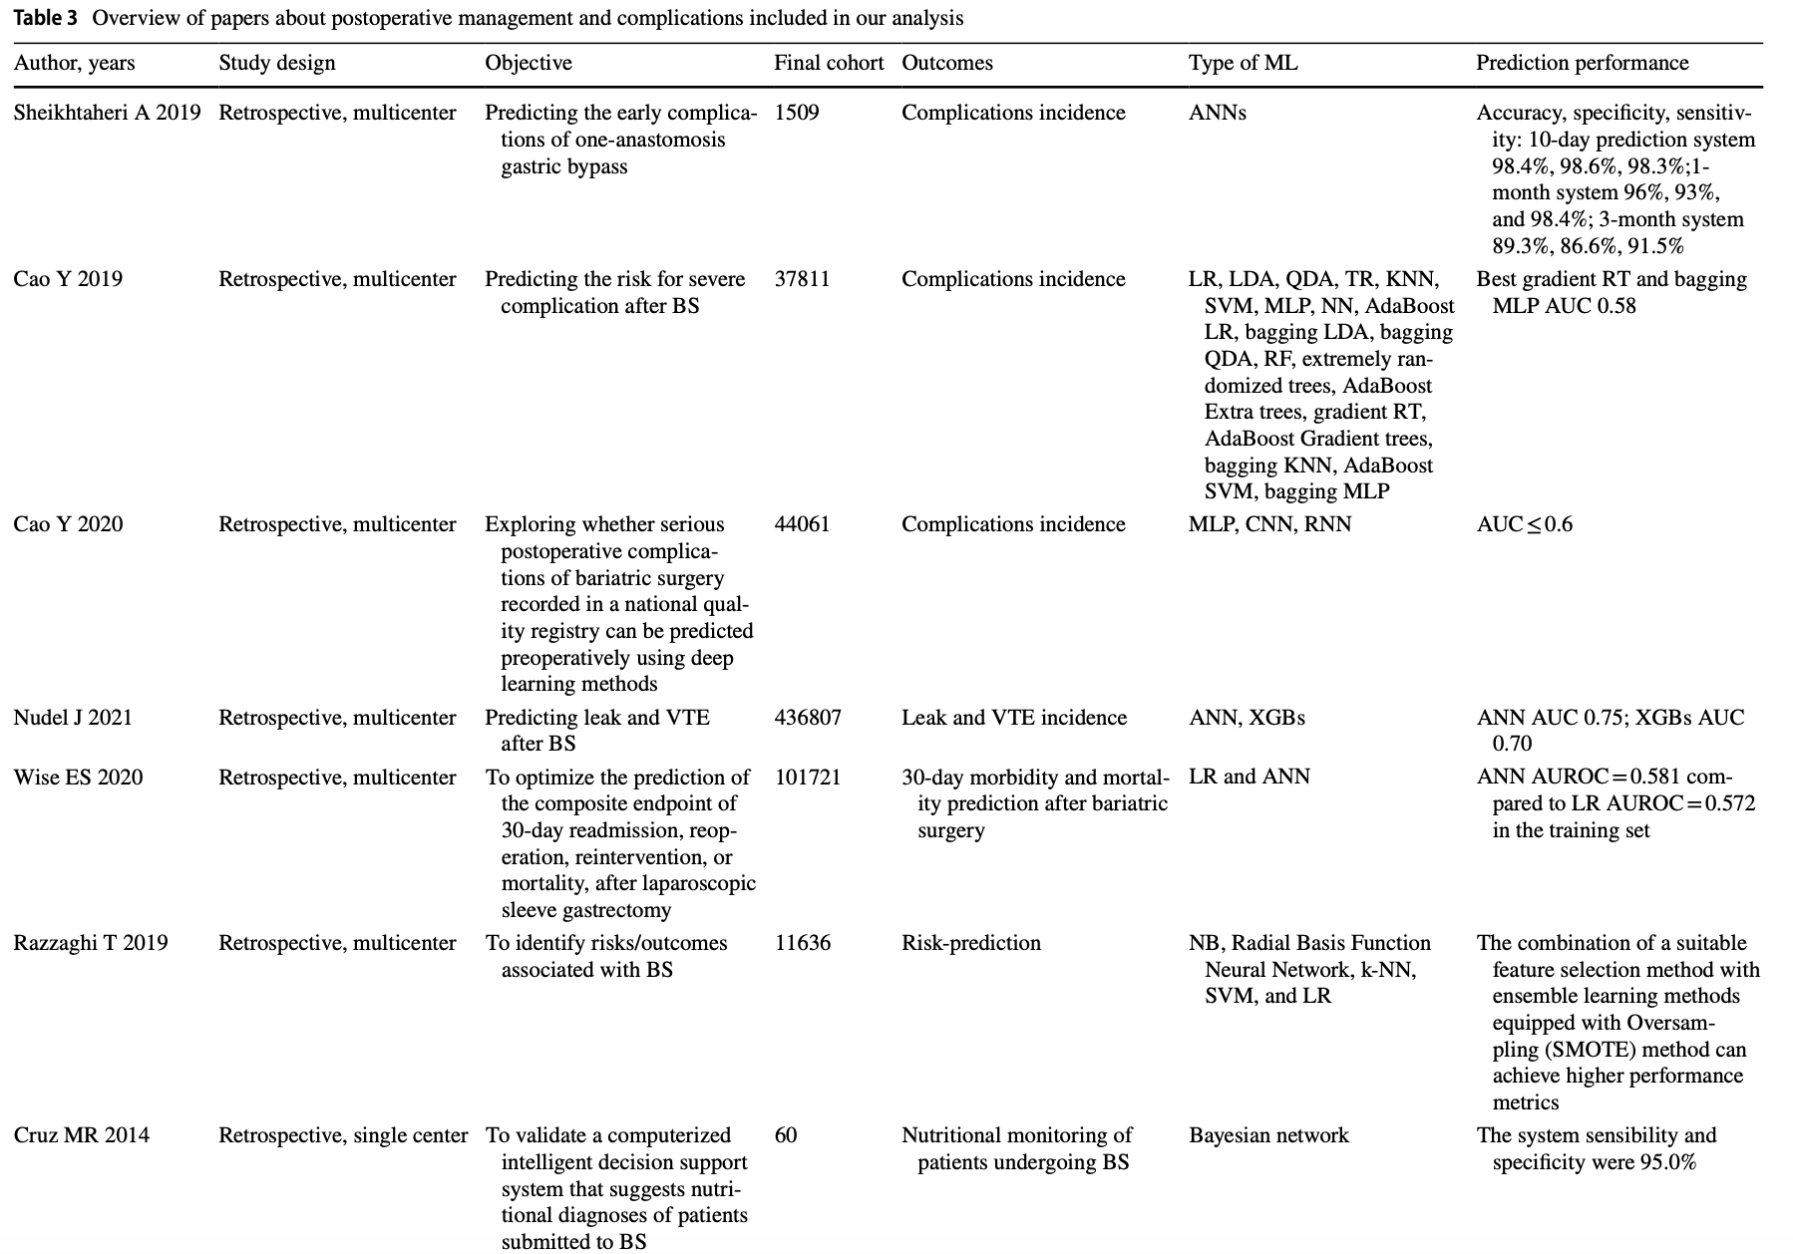

Slide 19
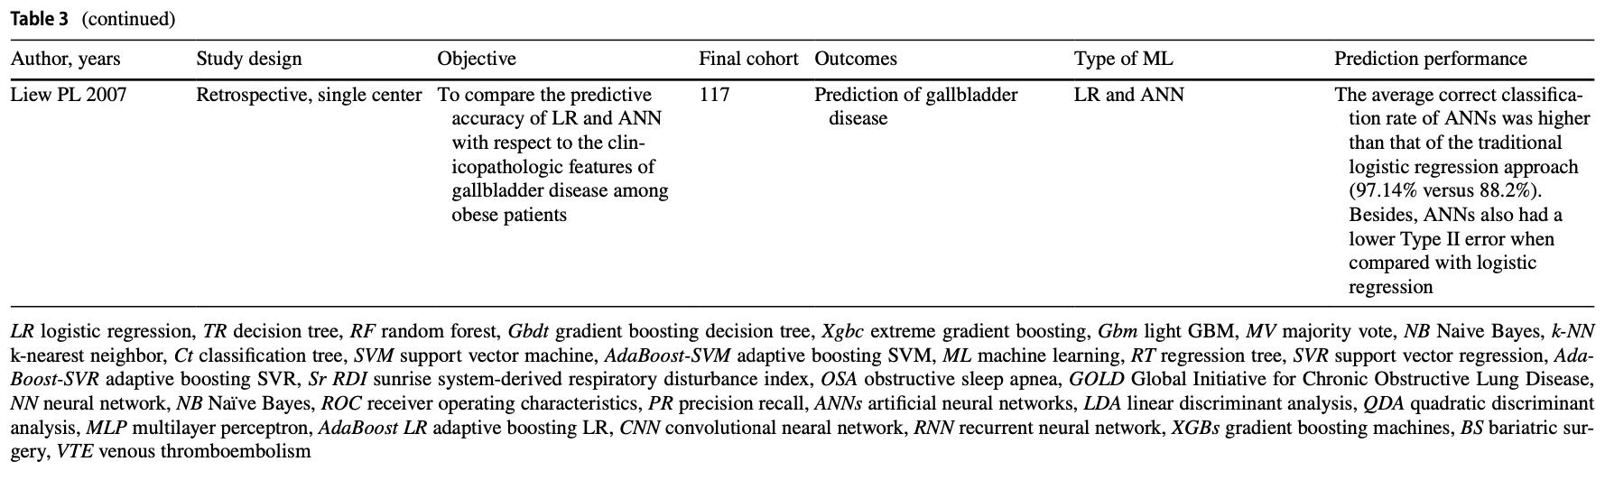

Slide 20
Conclusioni
Siamo solo all’inizio di una nuova era
L’uso di grandi modelli linguistici (estraggono info dai video chirurgici per creare report operativi) integrati con la computer vision (riconosce strutture anatomiche, fasi chirurgiche e anomalie in tempo reale) promette una comprensione più profonda delle dinamiche operatorie (Rau et al, arXiv 2025).
Progetti sperimentali come STAR (Smart Tissue Automoumous Robot) dimostrano la fattibilità di task chirurgiche autonome su tessuti molli. (Shademan et al, Science Transl Med 2016).
L’analisi continua delle performance permetterà di creare percorsi formativi su misura per ogni chirurgo (e.g., DS1 Touch Surgery, Medtronic).
Etica e responsabilità.

Slide 21
Grazie
cesana.giovanni@unisr.it

